Slide 1
Color, Gradients, and the Swatches Panel
Theory Assignment:
Color Theory Basics in Illustrator
Using Gradients
Color Guide Panel

Slide 2
Color, Gradients, and the Swatches Panel
Color Theory Basics in Illustrator:
Explain the difference between fills and strokes and how they are applied to objects.
Describe the role of the Swatches panel and how it helps manage colors in a design.

Slide 3
Explain the difference between fills and strokes and how they are applied to objects.
Fill: This is the color that fills the inside of the object. Imagine it as the paint covering the area within the object's outline.
Stroke: This is the color of the object's outline or border. It's like the line drawn around the edge of the object.
How They're Applied:
Select an object.
Choose a color or effect for the fill.
Choose a color or effect for the stroke.
Adjust stroke weight and style if needed.

Slide 4
Describe the role of the Swatches panel and how it helps manage colors in a design.
Swatches Panel: The Swatches panel is your color management hub. It's a collection of pre-defined colors, gradients, and patterns that you can quickly apply to your objects.
Here's how it helps:
Color Library: Provides a wide range of colors to choose from, often organized into categories (e.g., web-safe colors, CMYK colors).
Consistency: Makes it easy to maintain a consistent color palette throughout your design. If you need to change a color, you can edit the swatch, and all objects using that swatch will update automatically.
Organization: Allows you to create custom swatches and organize them into groups for different projects or design elements.

Slide 5
Color, Gradients, and the Swatches Panel
Using Gradients:
Define gradients and explain the difference between linear and radial gradients.
Describe how the Gradient tool and Gradient panel work together to create smooth color transitions.

Slide 6
Define gradients and explain the difference between linear and radial gradients.
Gradients: Gradients are a way to smoothly blend two or more colors together. Instead of a solid color, you get a gradual transition between hues. This can add depth, visual interest, and a sense of dimension to your designs.
Linear vs. Radial Gradients
Linear Gradient: Colors transition along a straight line. Imagine it like a color bar where one color smoothly fades into the next. You can control the angle of this line (e.g., horizontal, vertical, diagonal).
Radial Gradient: Colors transition outward from a central point. Think of it like a bullseye or a ripple effect, where colors radiate from the center. You can control the shape (circle, ellipse) and size of the gradient.

Slide 7
Describe how the Gradient tool and Gradient panel work together to create smooth color transitions.
Gradient Tool: This tool lets you apply and adjust gradients directly on your objects. You can click and drag to change the gradient's direction or position.
Gradient Panel: This panel provides detailed settings for your gradients.
You can:
Choose the gradient type (linear or radial).
Add or remove color stops (the points where colors change).
Adjust the color of each stop.
Control the blending between colors.
In short: The Gradient tool lets you interactively manipulate gradients, while the Gradient panel gives you fine-grained control over their properties.

Slide 8
Color, Gradients, and the Swatches Panel
Color Guide Panel:
Explain the Color Guide panel and how it assists in choosing harmonious colors for designs.
Describe what complementary, analogous, and triadic color schemes are.

Slide 9
Explain the Color Guide panel and how it assists in choosing harmonious colors for designs.
Color Guide Panel:
The Color Guide panel is a helpful tool for creating harmonious color palettes. It analyzes the colors you've already used in your design and suggests related colors that will likely look good together.
It offers various color harmony rules (like complementary, analogous, etc.) and lets you adjust the color variations (like tints, shades, and tones).
This takes the guesswork out of color selection and helps ensure your designs have a cohesive and visually appealing color scheme.

Slide 10
Describe what complementary, analogous, and triadic color schemes are.
Color Schemes
Complementary: These colors are opposite each other on the color wheel (e.g., red and green, blue and orange). They create high contrast and a vibrant look.
Analogous: These colors are next to each other on the color wheel (e.g., blue, blue-green, green). They create a calm and harmonious feel.
Triadic: These colors are evenly spaced on the color wheel, forming a triangle (e.g., red, yellow, blue).
They offer a balanced and vibrant palette.
Sources and related content

Slide 11
Color, Gradients, and the Swatches Panel
Practical Assignment:
Applying Colors and Swatches
Gradient Application
Color Guide Exercise

Slide 12
Color, Gradients, and the Swatches Panel
Applying Colors and Swatches:
Create a colorful design using a combination of basic shapes.
Use the Swatches panel to save and apply a custom color palette to the shapes.

Slide 13
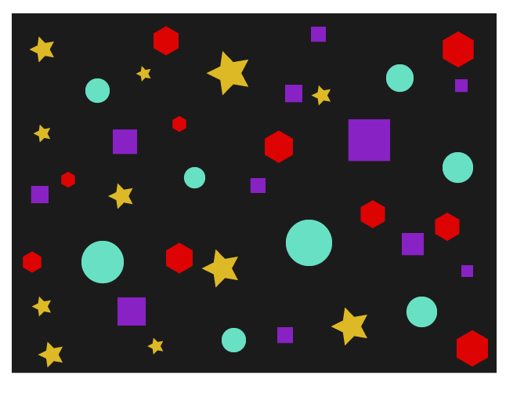
Create a colorful design using a combination of basic shapes.

Slide 14

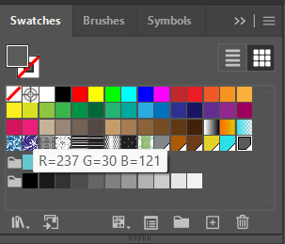
Use the Swatches panel to save and apply a custom color palette to the shapes.

Slide 15
Color, Gradients, and the Swatches Panel
Gradient Application:
Design a sunset or sunrise scene using linear and radial gradients to create smooth color transitions.
Experiment with gradient stops and transparency settings to achieve a realistic effect.

Slide 16

Design a sunset or sunrise scene using linear and radial gradients to create smooth color transitions. Experiment with gradient stops and transparency settings to achieve a realistic effect.

Slide 17
Color, Gradients, and the Swatches Panel
Color Guide Exercise:
Choose a primary color and use the Color Guide panel to create a complementary color scheme.
Apply this color scheme to a design of your choice, such as a logo or simple illustration.

Slide 18
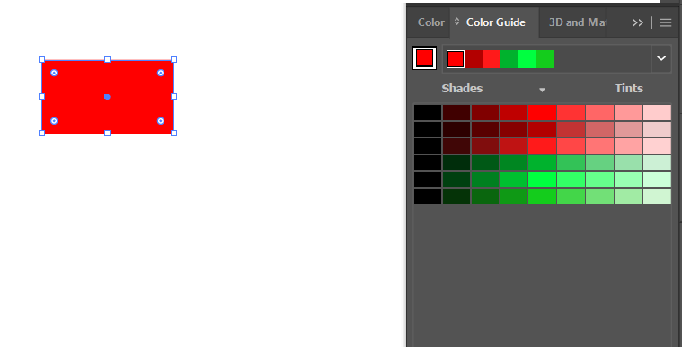
Choose a primary color and use the Color Guide panel to create a complementary color scheme.

Slide 19

Apply this color scheme to a design of your choice, such as a logo or simple illustration.

Slide 20
Typography and Text in Illustrator
Theory Assignment:
Introduction to Typography in Illustrator
Type on a Path
Character and Paragraph Panels

Slide 21
Typography and Text in Illustrator
Introduction to Typography in Illustrator:
Describe the Type tool and its primary uses in Illustrator.
Explain the importance of typography in design, including readability, hierarchy, and style

Slide 22
Describe the Type tool and its primary uses in Illustrator.
Type Tool
The Type tool in Illustrator is your go-to for adding text to your designs. You can create text in several ways:
Point Type: Click once to create a single line of text. Good for headlines or short labels.
Area Type: Click and drag to create a text box. Useful for paragraphs or longer blocks of text.
Path Type: Click on a path (like a circle or a wavy line) to make the text flow along that path. Great for creative text layouts.

Slide 23
Explain the importance of typography in design, including readability, hierarchy, and style
Typography is much more than just putting words on a page. It's a crucial element of design that impacts how your message is received.
Here's why it's important:
Readability: Choosing the right font, size, and spacing makes your text easy to read and understand. If people can't read it, they won't get your message.
Hierarchy: Using different font sizes, weights (bold, light), and styles (italic) creates a visual hierarchy. This guides the reader's eye and shows them what's most important. Think of a headline being larger than the body text.
Style: Fonts have personalities! A playful font can be great for a children's book, while a classic serif font might be better for a formal document. Your font choices should match the overall style and tone of your design.

Slide 24
Typography and Text in Illustrator
Type on a Path:
Define Type on a Path and explain when it might be used (e.g., circular logos or badges).
Describe how text can be manipulated along paths and shapes.

Slide 25
Define Type on a Path and explain when it might be used (e.g., circular logos or badges).
Type on a Path lets you flow text along any path or shape you create in Illustrator. This means your text can follow curves, circles, or even custom-drawn lines.
When to Use It:
Circular Logos or Badges: Perfect for making text wrap around a circular design element.
Labels on Curved Objects: Imagine labeling a curved bottle or product. Type on a Path can make the text follow the curve.
Decorative Text: Add a touch of flair to your designs by making text flow along a wave or a spiral.

Slide 26
Describe how text can be manipulated along paths and shapes.
Illustrator gives you a lot of control over how your text sits on a path:
Positioning: You can easily drag the text along the path to find the perfect placement.
Alignment: Control how the text aligns to the path (e.g., centered, left-aligned, right-aligned).
Path Options: Fine-tune the text's orientation and how it wraps around the path using the Type on a Path Options dialog box.
In essence: Type on a Path lets you break free from straight lines and add a dynamic touch to your text.

Slide 27
Typography and Text in Illustrator
Character and Paragraph Panels:
Explain the functions of the Character and Paragraph panels, such as kerning, tracking, leading, and alignment.
Discuss the impact of font choice and spacing on design aesthetics.

Slide 28
Explain the functions of the Character and Paragraph panels, such as kerning, tracking, leading, and alignment.
Character Panel: Focuses on individual characters (letters).
Here you can adjust:
Kerning: The spacing between specific pairs of letters (e.g., adjusting the space between a "T" and an "a").
Tracking: The uniform spacing between all characters in a selected text.
Font: Choose your typeface.
Size: Set the point size of your text.
Style: Choose bold, italic, etc.

Slide 29
Explain the functions of the Character and Paragraph panels, such as kerning, tracking, leading, and alignment..
Paragraph Panel: Controls the overall formatting of paragraphs.
You can adjust:
Leading: The vertical spacing between lines of text.
Alignment: How the text aligns within its box (left, center, right, justified).
Indentation: Set how far the first line of a paragraph is indented.

Slide 30
Discuss the impact of font choice and spacing on design aesthetics.
Font Choice: A font's style heavily influences the mood of your design. A playful script font will feel very different from a serious serif font. Choosing the right font is crucial for conveying the right message.
Spacing: Proper spacing (kerning, tracking, leading) is essential for readability and visual appeal.
Too little space makes text cramped and hard to read; too much space can make it feel disjointed.
Good spacing creates a comfortable and professional look. It also contributes to visual hierarchy.

Slide 31
Typography and Text in Illustrator
Practical Assignment:
Creating a Typographic Poster
Type on a Path Exercise
Custom Text Effects

Slide 32
Typography and Text in Illustrator
Creating a Typographic Poster:
Design a typographic poster that uses a mix of font sizes, styles, and alignments.
Experiment with bold, italic, and decorative fonts, focusing on creating visual hierarchy.

Slide 33
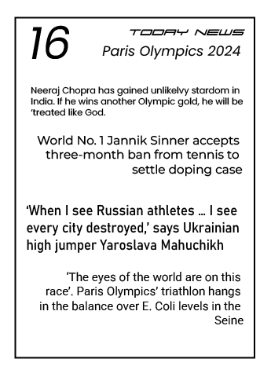
Design a typographic poster that uses a mix of font sizes, styles, and alignments.

Slide 34
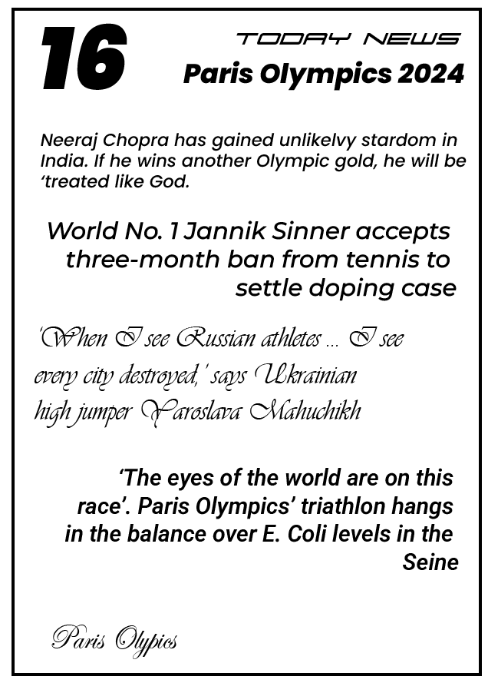
Experiment with bold, italic, and decorative fonts, focusing on creating visual hierarchy.

Slide 35
Typography and Text in Illustrator
Type on a Path Exercise:
Draw a circle and use the Type on a Path tool to create circular text.
Customize the font, size, and positioning of the text around the circle to create a badge or label design.

Slide 36
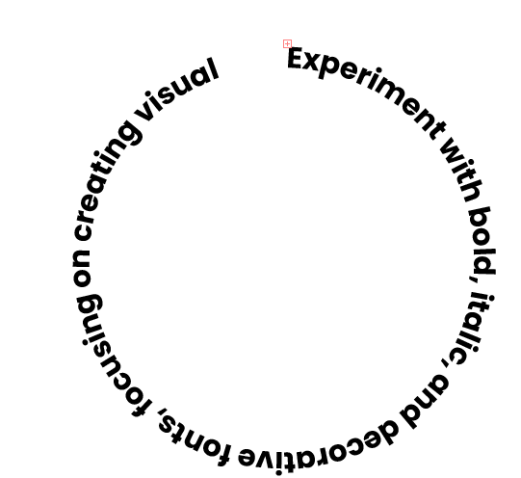
Draw a circle and use the Type on a Path tool to create circular text.

Slide 37
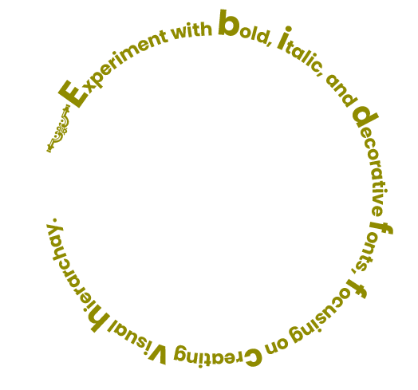
Draw a circle and use the Type on a Path tool to create circular text.

Slide 38
Typography and Text in Illustrator
Custom Text Effects:
Apply effects such as shadows, outlines, and textures to a large heading or title.
Experiment with different font styles and layer effects to create a unique design for a poster or social media post.
Use Appearance panel with effects for editable text effect

Slide 39
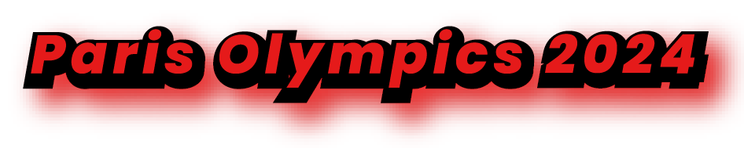
Apply effects such as shadows, outlines, and textures to a large heading or title.

Slide 40

Experiment with different font styles and layer effects to create a unique design for a poster or social media post. Use Appearance panel with effects for editable text effect.

Slide 41
Working with Layers, Masks, and Opacity
Theory Assignment:
Layers Panel
Opacity and Blending Modes
Masks

Slide 42
Working with Layers, Masks, and Opacity
Layers Panel:
Explain the importance of layers in Illustrator and how they assist in organizing complex designs.
Describe how layers can be locked, hidden, and rearranged.

Slide 43
Explain the importance of layers in Illustrator and how they assist in organizing complex designs.
Layers are like transparent sheets of paper stacked on top of each other. They allow you to organize your artwork into separate levels, making complex designs much easier to manage.
Importance of Layers
Organization: Layers help you keep track of different elements in your design.
Editing: You can work on one layer without affecting others.
Selective Visibility: You can hide or show layers to focus on specific parts of your artwork or to create different versions of your design.
Stacking Order: Layers control the stacking order of objects. Items on higher layers will appear in front of items on lower layers.

Slide 44
Describe how layers can be locked, hidden, and rearranged.
Locking: Locking a layer prevents any editing to its contents. This is great for protecting elements you don't want to accidentally move or change.
Hiding: Hiding a layer makes its contents invisible. This is useful for temporarily removing elements from view or for creating different versions of your design.
Rearranging: You can easily change the stacking order of layers by dragging them up or down in the Layers panel. This allows you to control which objects appear in front of others.

Slide 45
Working with Layers, Masks, and Opacity
Opacity and Blending Modes:
Define opacity and explain how adjusting it can create transparency effects.
Describe blending modes and their use in achieving different visual effects.

Slide 46
Define opacity and explain how adjusting it can create transparency effects.
Opacity refers to how see-through an object is. A 100% opaque object is completely solid, while a 0% opaque object is completely invisible. Adjusting opacity allows you to create transparency effects, making objects appear translucent.
Creating Transparency
By lowering an object's opacity, you allow underlying artwork to show through. This can be used to create subtle overlays, ghosting effects, or to make elements blend seamlessly into the background.

Slide 47
Describe blending modes and their use in achieving different visual effects.
Blending modes control how colors of overlapping objects interact. They offer a wide range of visual effects beyond simple transparency.
Here are a few common examples:
Multiply: Darkens the colors, often used for shadows or creating a printed look.
Screen: Lightens the colors, useful for highlights or glows.
Overlay: Combines the effects of Multiply and Screen, creating vibrant and high-contrast results.
Difference: Shows the difference between the colors, creating unusual and often psychedelic effects.

Slide 48
Working with Layers, Masks, and Opacity
Masks:
Explain what clipping masks are and when to use them.
Describe how clipping masks can help confine artwork to a specific shape.
Use of Opacity mask in Creating illustration

Slide 49
Explain what clipping masks are and when to use them.
Imagine you have a cookie cutter (your clipping mask) and some dough (your artwork). A clipping mask works similarly: it's a shape that "cuts out" or reveals only the portion of your artwork that falls within its boundaries. Anything outside the mask's shape is hidden.
When to Use Them:
Containing Images: Easily place images within specific shapes (circles, stars, custom outlines) without having to precisely crop the image.
Creating Unique Text Effects: Fill text with images or patterns, giving your typography a visually interesting look.
Designing Logos: Confine elements within a logo shape for a clean and professional appearance.
Isolating Artwork: Focus on specific parts of your design by masking off the rest.

Slide 50
Describe how clipping masks can help confine artwork to a specific shape.
How They Work:
Create a Shape: This will be your clipping mask.
Place Artwork: Position the artwork you want to mask on top of the shape.
Make Clipping Mask: Select both the shape and the artwork, then use the "Make Clipping Mask" command (Object > Clipping Mask > Make).

Slide 51
Use of Opacity mask in Creating illustration
Opacity masks are incredibly useful for creating complex and realistic effects in illustrations:
Textured Surfaces: Use a texture image as an opacity mask to give your objects a realistic surface.
Soft Shadows and Highlights: Create subtle transitions between light and shadow.
Foliage and Hair: Achieve a natural look with complex shapes and varying density.
In summary: Clipping masks confine artwork to a specific shape, while opacity masks control transparency based on grayscale values, both being powerful tools for creating professional and visually appealing designs.

Slide 52
Working with Layers, Masks, and Opacity
Practical Assignment:
Layer Organization Practice
Blending Mode and Opacity Exercise
Clipping Mask Project

Slide 53
Working with Layers, Masks, and Opacity
Layer Organization Practice:
Create a design (e.g., a landscape scene or abstract composition) and organize different elements on separate layers.
Use layer names, locking, and hiding to manage the design effectively

Slide 54

Create a design (e.g., a landscape scene or abstract composition) and organize different elements on separate layers. Use layer names, locking, and hiding to manage the design effectively.

Slide 55
Working with Layers, Masks, and Opacity
Blending Mode and Opacity Exercise:
Design a poster or background image that utilizes blending modes and opacity adjustments for added depth.
Experiment with various blending modes to see how they affect overlapping elements.
Create basic image Using Opacity mask.

Slide 56

Design a poster or background image that utilizes blending modes and opacity adjustments for added depth.

Slide 57
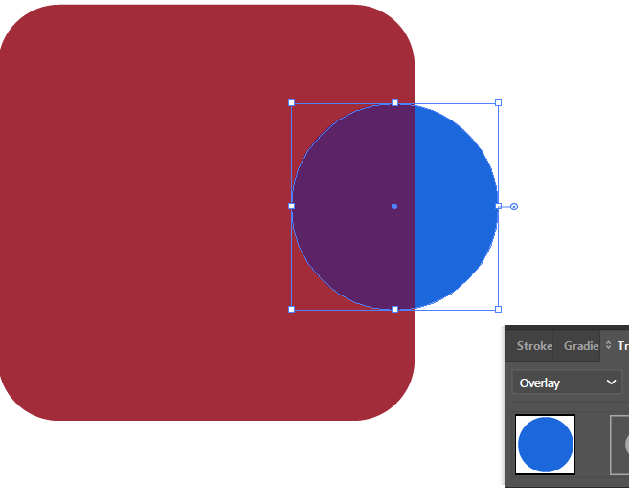
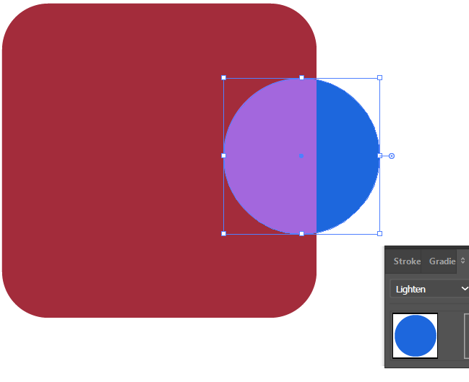
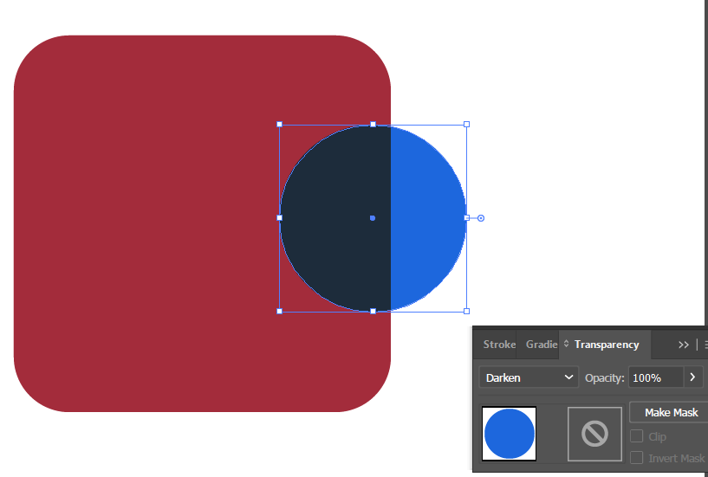
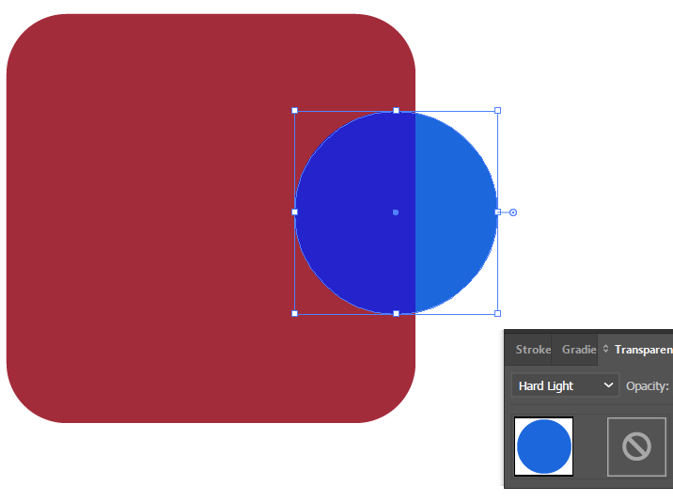
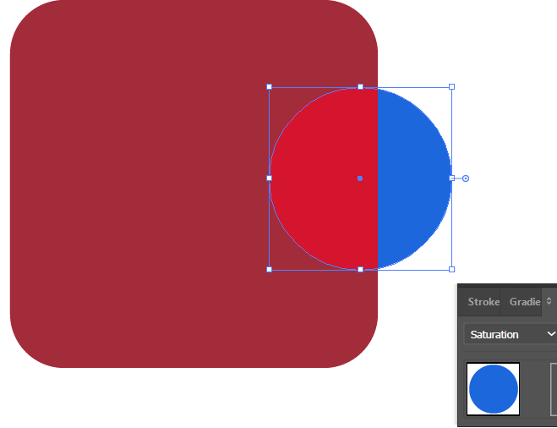
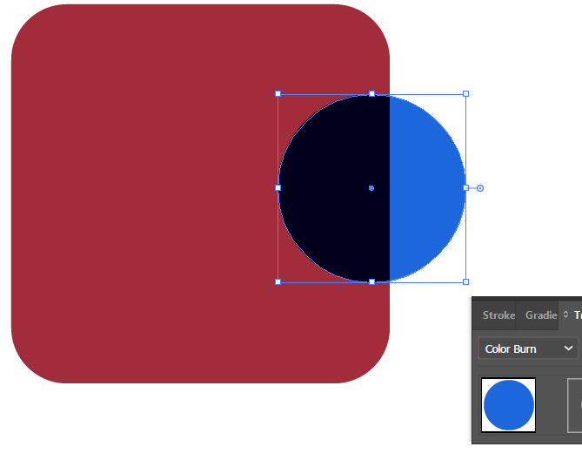
Experiment with various blending modes to see how they affect overlapping elements.

Slide 58
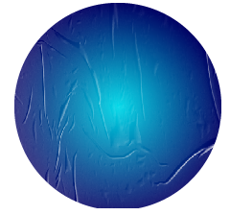
Create basic image Using Opacity mask.

Slide 59
Working with Layers, Masks, and Opacity
Clipping Mask Project:
Use a clipping mask to place an image or texture inside text or a shape.
Create a poster that combines text with a masked background image to achieve an unique visual effect.

Slide 60
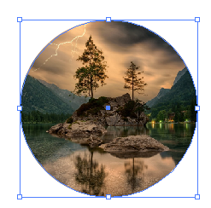
Use a clipping mask to place an image or texture inside text or a shape.

Slide 61

Create a poster that combines text with a masked background image to achieve an unique visual effect.

Slide 62
Icon Design and Vector Illustrations
Theory Assignment:
Importance of Icons in Design
Working with Vectors

Slide 63
Icon Design and Vector Illustrations
Importance of Icons in Design:
Define icons and explain their role in user interfaces and visual communication.
Describe the characteristics of effective icons (e.g., simplicity, scalability, clarity).

Slide 64
Define icons and explain their role in user interfaces and visual communication.
Icons are small, visual symbols that represent objects, actions, or ideas. They're a universal language, quickly conveying meaning without the need for words.
Role in UI and Visual Communication:
User Interfaces (UI): Icons are essential in UIs to guide users, make navigation intuitive, and enhance usability. Think of the icons on your phone or computer representing apps, files, or functions.
Visual Communication: Icons transcend language barriers, making them ideal for communicating information quickly and effectively in various contexts, like signage, maps, or infographics.

Slide 65
Describe the characteristics of effective icons (e.g., simplicity, scalability, clarity).
Characteristics of Effective Icons:
Simplicity: Icons should be clean and easily recognizable, avoiding unnecessary details that can clutter the design.
Scalability: Icons must look good at different sizes, from small app icons to larger website graphics. They should maintain clarity and detail even when scaled up or down.
Clarity: The meaning of an icon should be immediately clear to the user. Avoid abstract or ambiguous symbols that could be misinterpreted.
Consistency: Use a consistent style and design language for all icons within a project.

Slide 66
Icon Design and Vector Illustrations
Working with Vectors:
Explain the difference between vector and raster images, and why vectors are ideal for logos and icons.
Discuss the advantages of creating vector illustrations in Illustrator.

Slide 67
Explain the difference between vector and raster images, and why vectors are ideal for logos and icons.
Raster Images:
These are made up of a grid of tiny pixels, like a digital photograph. When you zoom in, you can see the individual pixels. Raster images are resolution-dependent, meaning they can appear blurry or pixelated when scaled up. Common file types include JPEG, PNG, and GIF.
Vector Images:
These are created using mathematical equations that define lines, curves, and shapes. Vector images are resolution-independent, meaning they can be scaled infinitely without losing quality. They always appear crisp and clear, no matter how much you zoom in. Common file types include AI, SVG, and EPS.

Slide 68
Explain the difference between vector and raster images, and why vectors are ideal for logos and icons.
Why Vectors are Ideal for Logos and Icons:
Scalability: Logos and icons often need to be used in various sizes, from small website icons to large print materials. Vectors ensure they look sharp at any size.
Editability: Vector graphics can be easily edited and modified without losing quality. This is crucial for making revisions or adapting logos for different applications.
Small File Size: Vector files tend to be smaller than raster files, making them efficient for web use and storage.

Slide 69
Discuss the advantages of creating vector illustrations in Illustrator.
Advantages of Vector Illustrations in Illustrator
Precise Control: Illustrator provides tools for precise drawing and manipulation of vector shapes, giving you fine-grained control over your artwork.
Versatility: Create everything from simple icons to complex illustrations. Illustrator is a versatile tool for a wide range of design tasks.
Industry Standard: Illustrator is the industry-standard software for vector graphics, making it compatible with other design tools and workflows.

Slide 70
Icon Design and Vector Illustrations
Practical Assignment:
Design an Icon Set
Vector Illustration Practice

Slide 71
Icon Design and Vector Illustrations
Design an Icon Set:
Create a set of 5–10 icons (e.g., for a weather app, website, or travel app).
Ensure that the icons are consistent in style, size, and line weight.

Slide 72

Create a set of 5–10 icons (e.g., for a weather app, website, or travel app). Ensure that the icons are consistent in style, size, and line weight.

Slide 73
Icon Design and Vector Illustrations
Vector Illustration Practice:
Design a simple vector illustration (e.g., an animal, plant, or cartoon character).
Use the Pen tool, shapes, and colors to bring the illustration to life, focusing on clean lines and simplicity.

Slide 74

Design a simple vector illustration (e.g., an animal, plant, or cartoon character). Use the Pen tool, shapes, and colors to bring the illustration to life, focusing on clean lines and simplicity.

